Slide 1

CLINIC MANAGEMENT SYSTEM
ADBMS MINI PROJECT
Group 3
33312 - Kshitij Deshpande
33313 - Vedant Deshpande
33323 - Aditya Kangune
33356 - Yash Patwardhan

Slide 2
CONTENTS
Problem Statement
Idea of the project
Abstract
User Journey
Security Features
Technology
Value & Impact
Implementation Screenshots
Future Scope
References

Slide 3

PROBLEM STATEMENT
Develop a centralised digital prescription application - instead of having to physically prescribe medicines which are then given to a pharmacist, design a Role Based Access Control application which handles this end to end. A doctor should be able to prescribe medicines with dosages to a patient on his terminal who can then go to any pharmacy and get them. The system must be secure and external stakeholders shouldn't have access to records shared between 2 parties in any case.

Slide 4
PROJECT IDEA
Developing a secure portal where a doctor can connect with all their patients, access all the medical records, previous prescriptions and address new medical issues of the patients at one place.
The patients will be able to see their prescription history including the latest prescription issued by the doctor. The patient can go to the pharmacy or contact their pharmacist who is the third stakeholder in this project.
A pharmacist can also sign up on the platform but they will only be able to login through an OTP sent to the registered email ID of the patient who has contacted them.

Slide 5
ABSTRACT

Slide 6
USER JOURNEY - DOCTOR
Fast and secure sign up feature.
Login will be possible only through registered email ID & account password. After login, the doctor will be able to see their profile and patients data.
After clicking on My Patients, they can see the medical history as well as submit a new prescription based on the recent consultation.

Slide 7
USER JOURNEY - PATIENT
Fast and secure sign up feature.
Login will be possible only through registered email ID & account password.
After login, the patient will be able to see ONLY THEIR OWN profile and prescription history.
If a new prescription has been submitted by their doctor, they will receive it on their dashboard.
There is one-to-one correspondence between the doctor and patient. One patient's data cannot be accessed or tampered by any other patient or user.

Slide 8
USER JOURNEY - PHARMACIST
Fast and secure sign up feature.
Login will be possible only through registered email ID and account Password The next step of verification requires the pharmacist to enter the email ID of the patient and OTP is sent to the registered email ID of the patient.
After login, the pharmacist will be able to see only that particular patient's most recent prescription.
The pharmacist does not have access to any other information about the patients and doctors registered on the portal.

Slide 9
SECURITY FEATURES IN THE PROJECT
The platform uses the passport library for authentication (json web tokens are used for session management).
Access is granted to the pharmacist only after consent of patient. (OTP service is used)
Passwords are encrypted (hashed) using bcrypt library so that they are not exposed.
Patients can access only their own data and not of other patients. Implementing blockchain features (future scope).

Slide 10
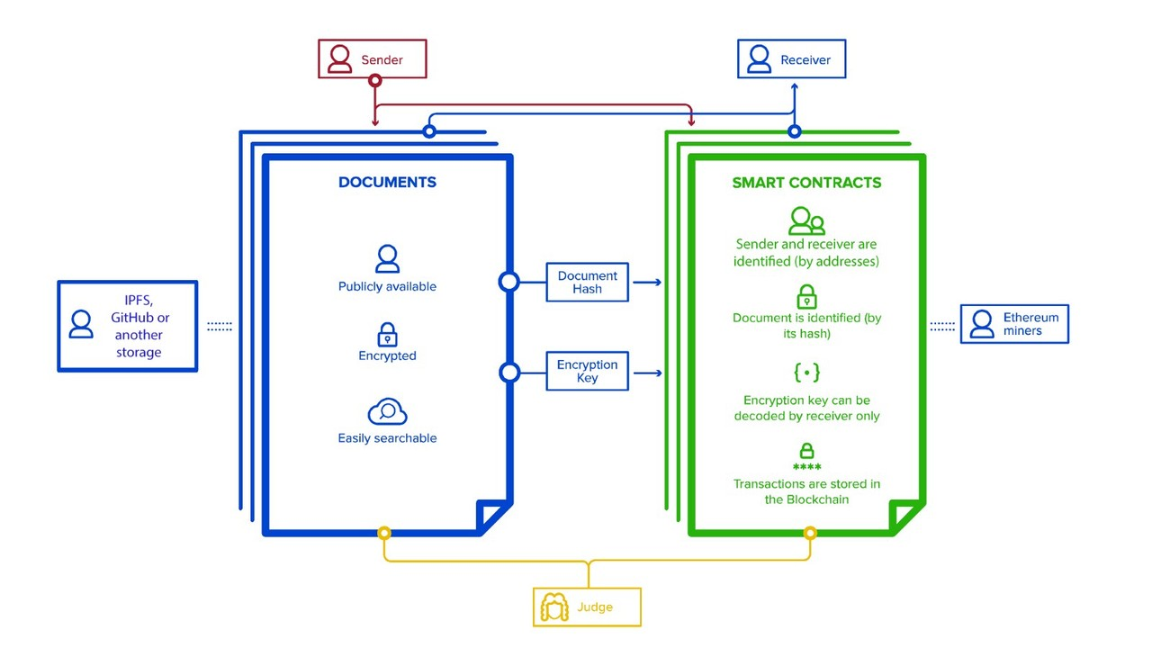
TECHNOLOGY
Designing
Security/Privacy
Figma UI Designing - Exploring Blockchain
Website Development
HTML
Styling - CSS + Bootstrap
Javascript
Database - MongoDB
Backend - NodeJS/Express

Slide 11
VALUE & IMPACT
Common platform for doctors, patients & pharmacists. Solving the problem of handwritten prescriptions.
Solving the problem of keeping track of medical history of each patient in paper format.
Solves the problem of going physically to medical shop, fast access to
prescription for pharmacist.
Fast and secure system where patient's data is protected and not accessible by any other patient or user.
Patients with recurrent health problems can get prescriptions without any hassle.

Slide 12
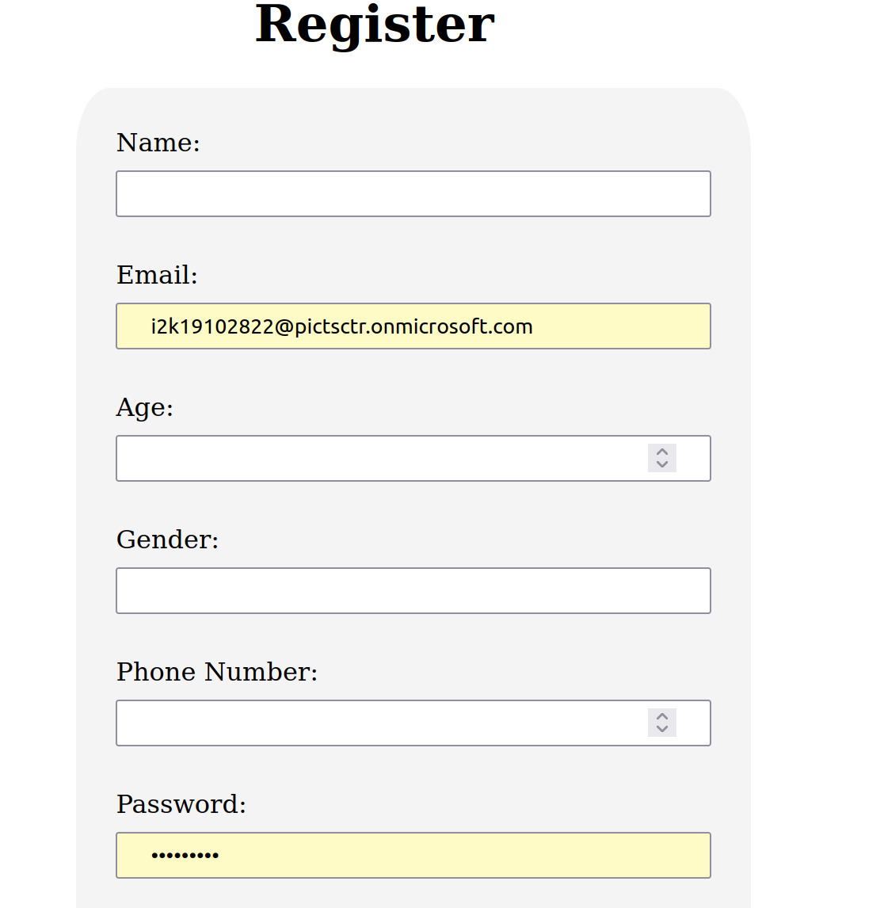
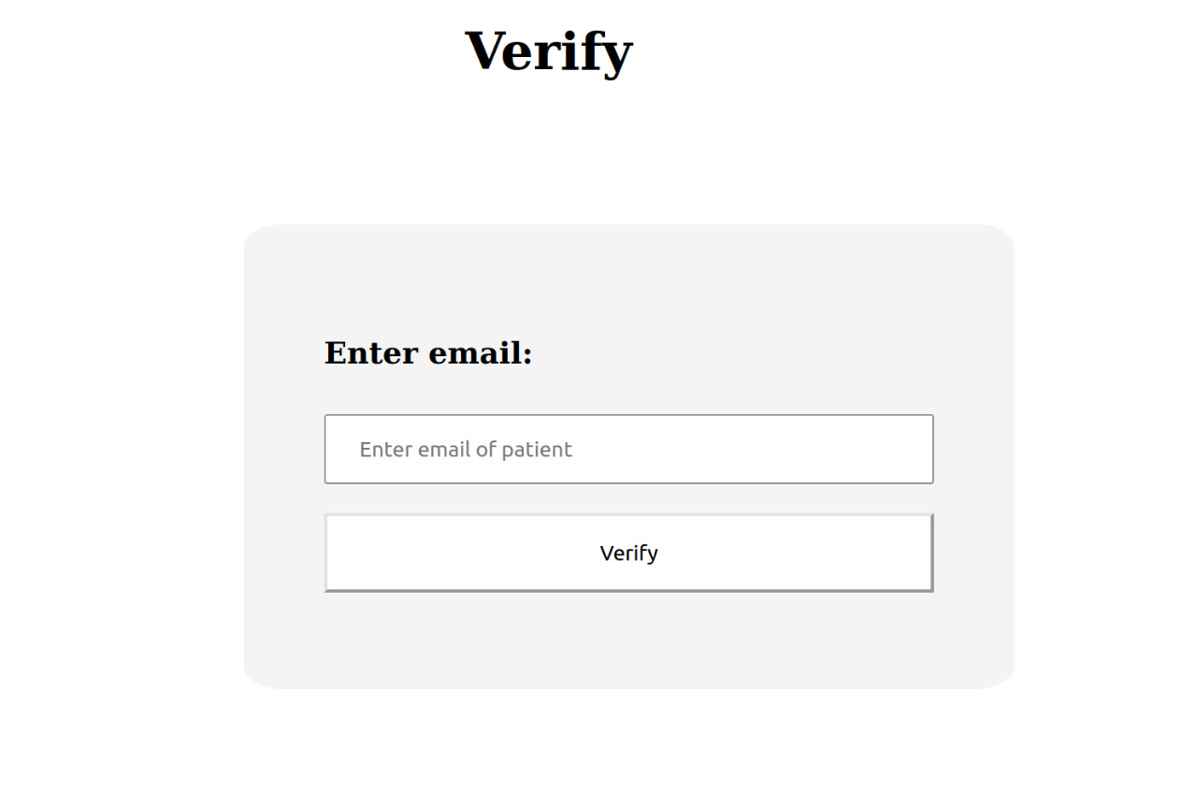
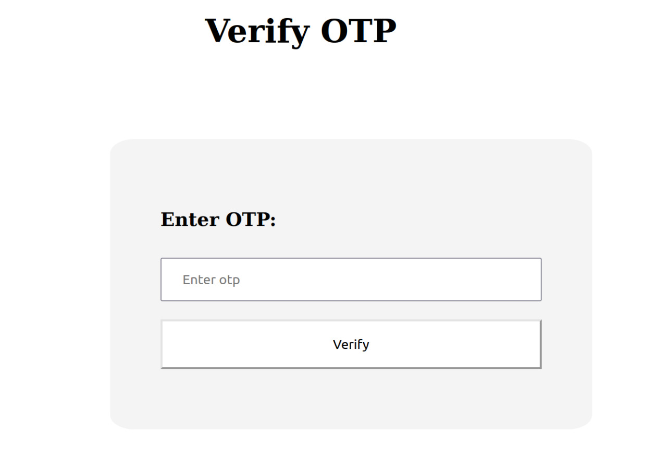
IMPLEMENTATION SCREENSHOTS

Slide 13
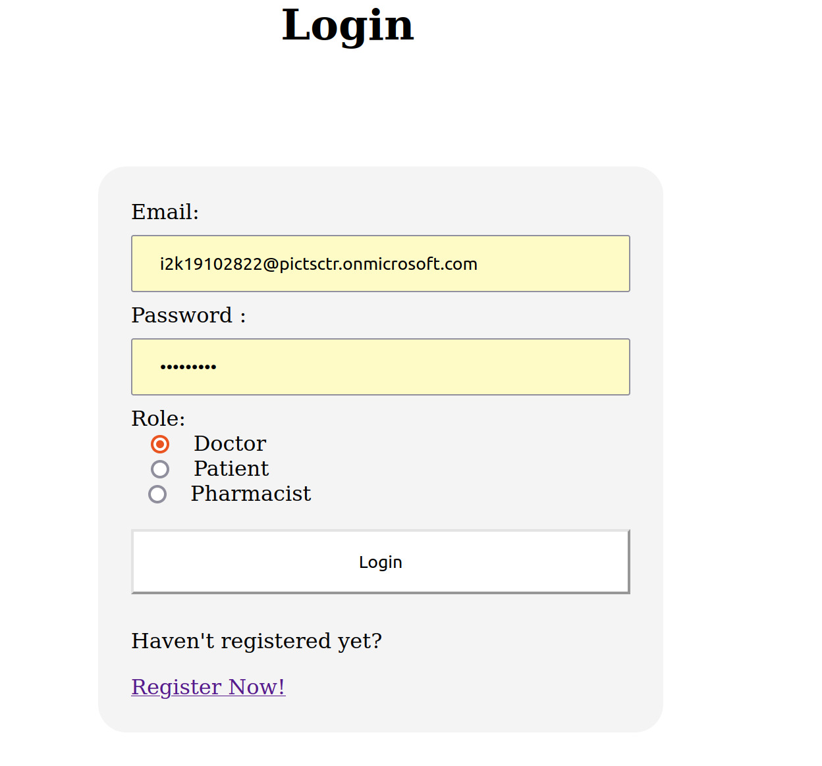
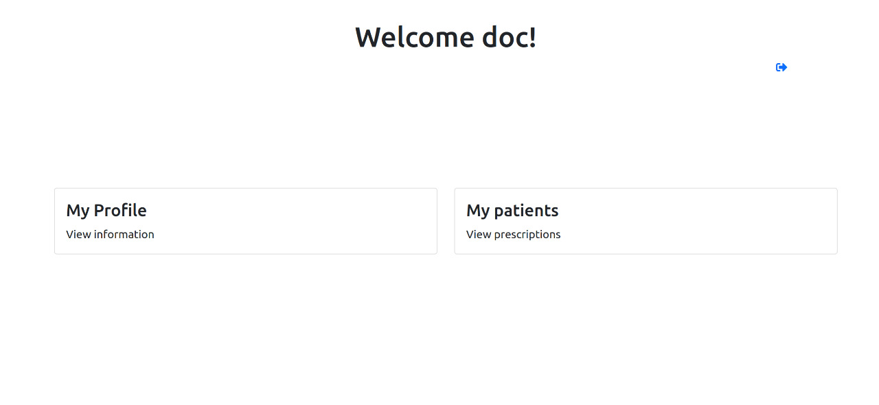

Slide 14
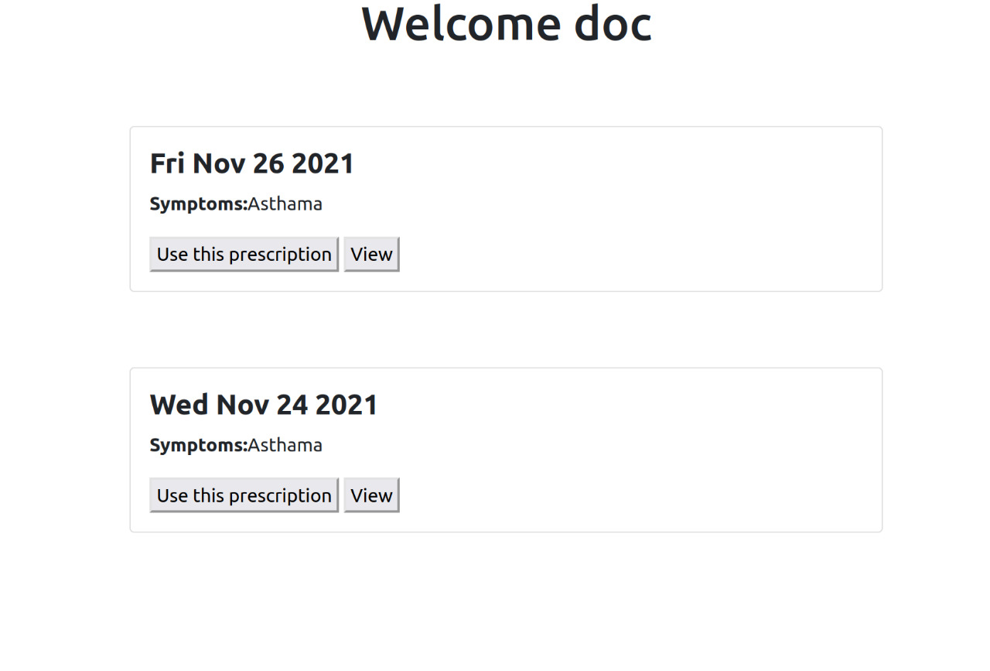
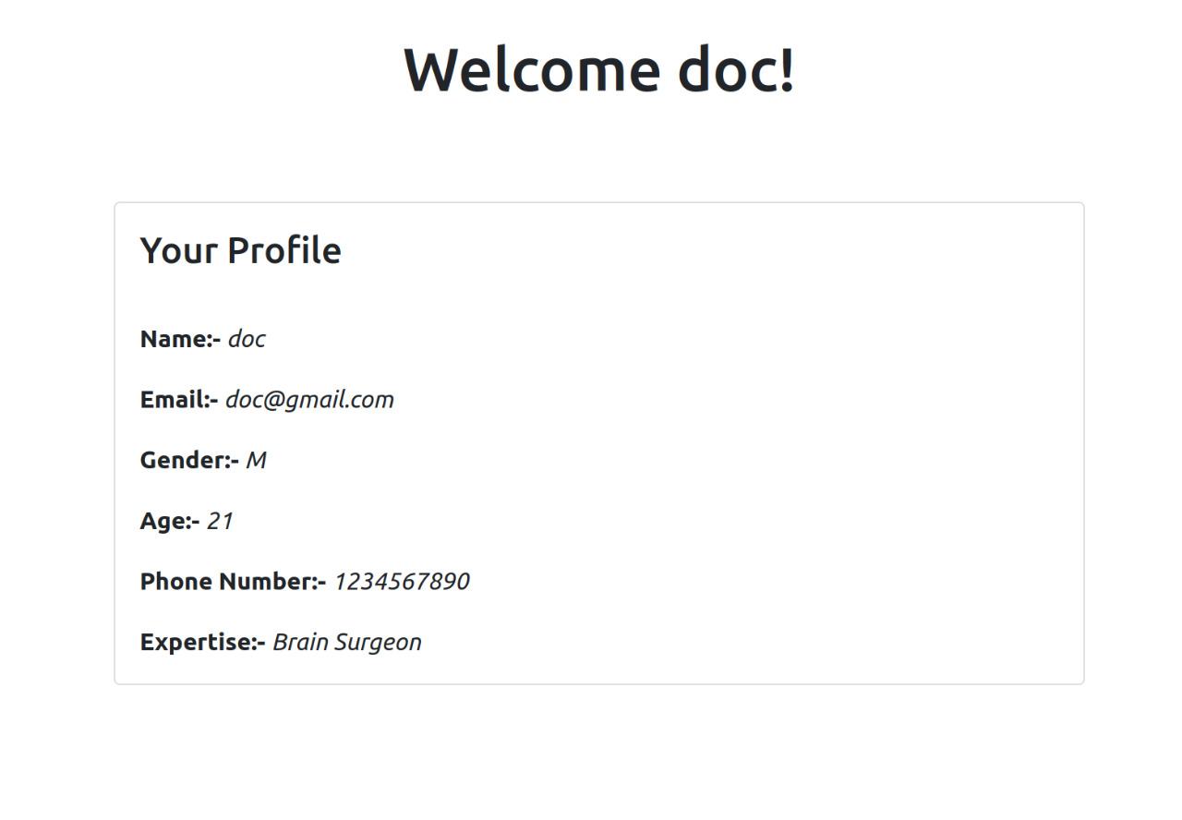

Slide 15
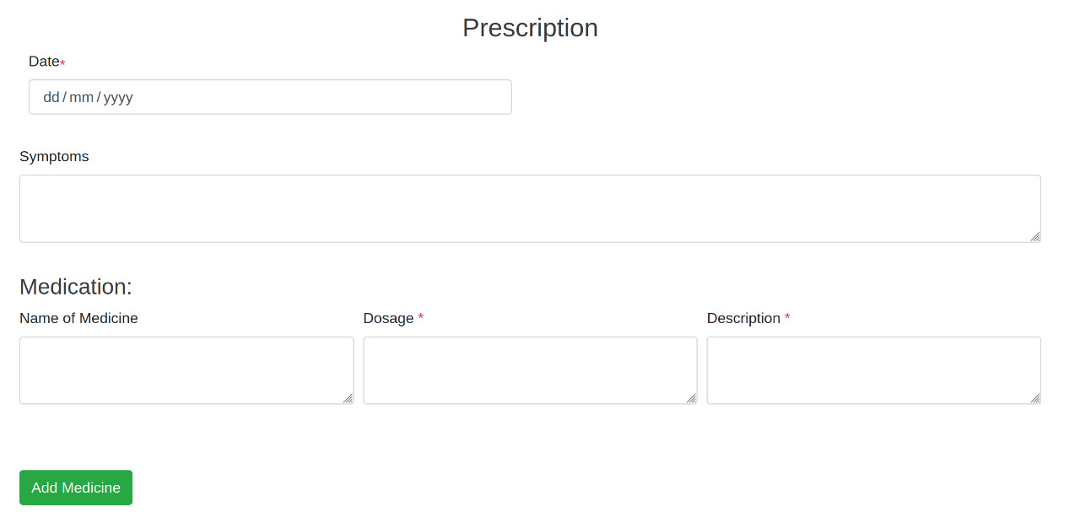

Slide 16
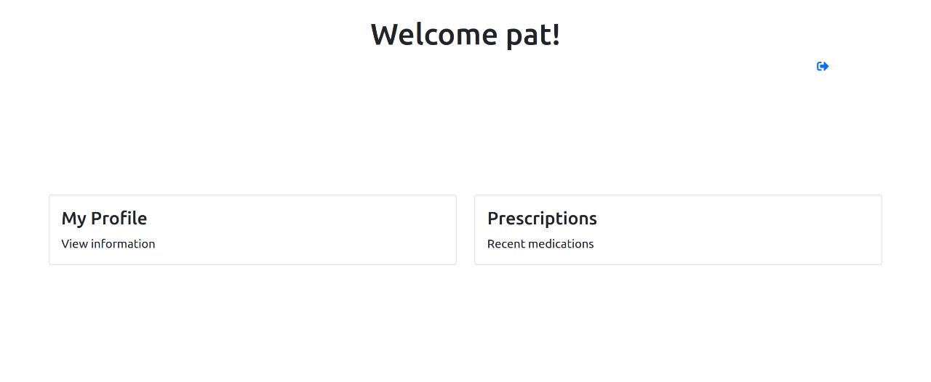
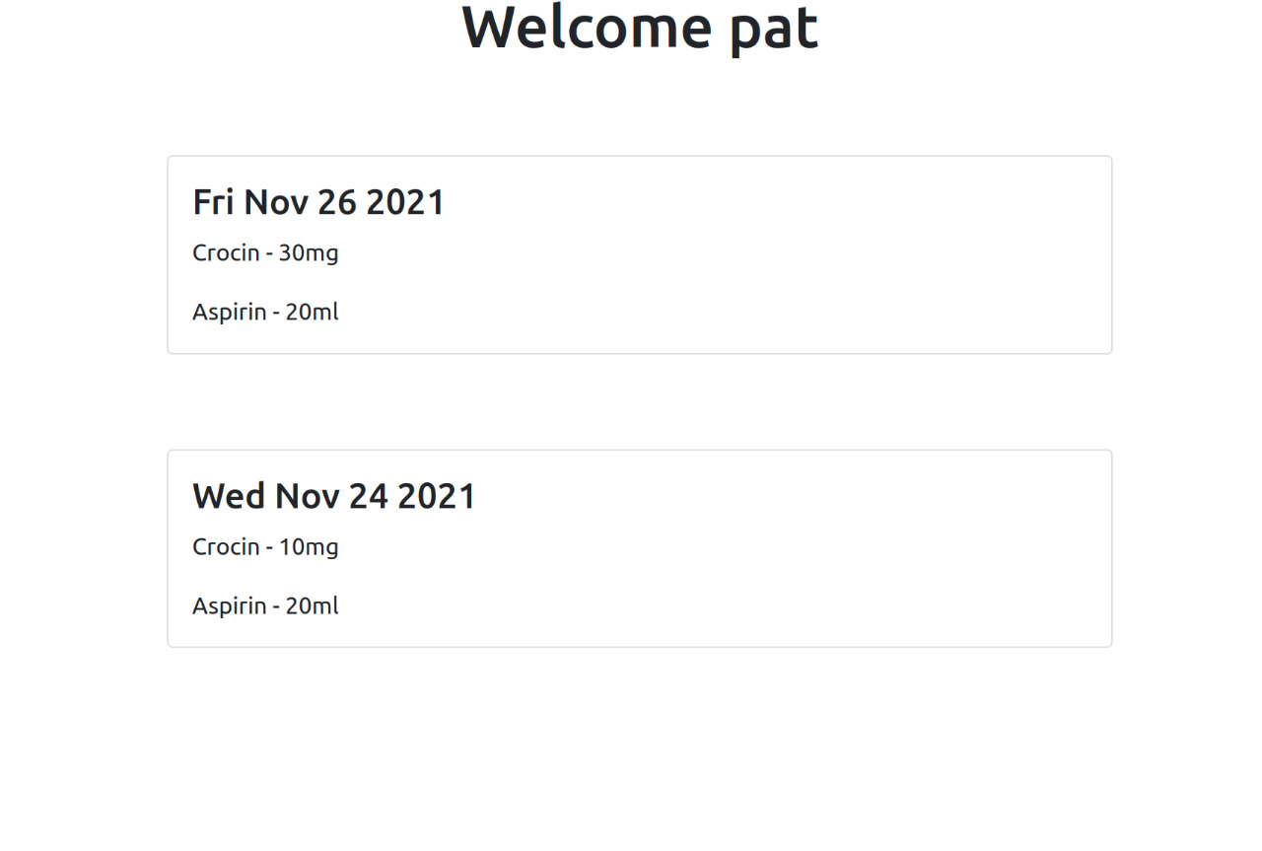
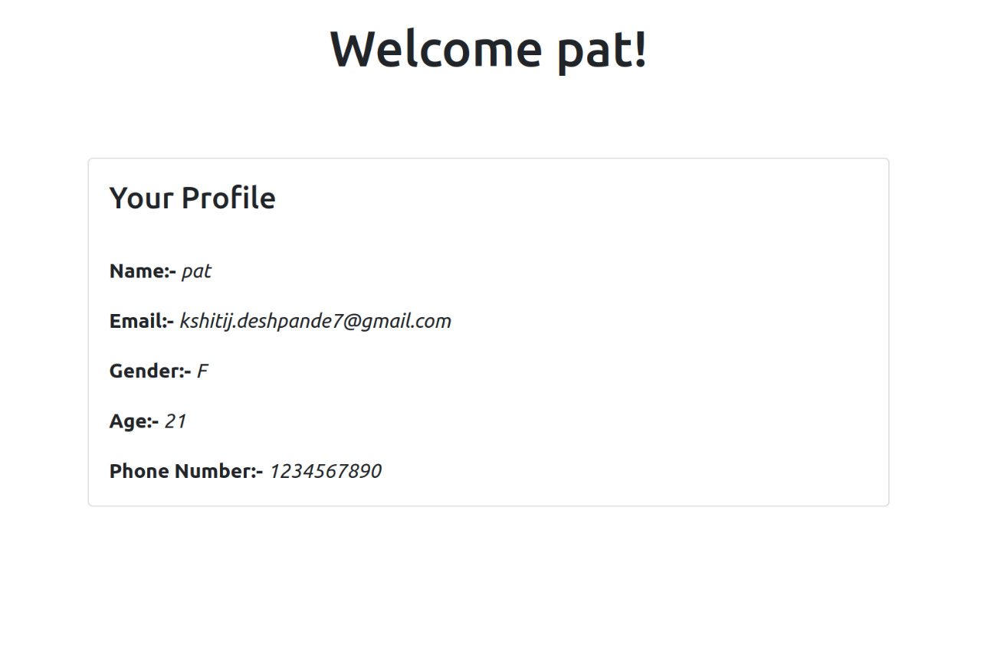

Slide 17
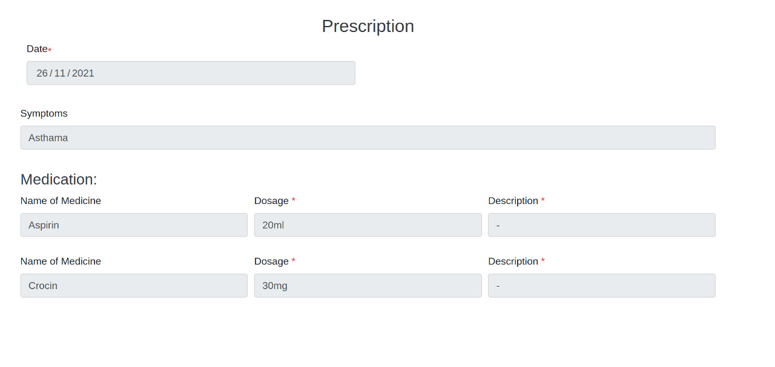

Slide 18
Video calling & chat feature to interact virtually with the doctor securely.
FUTURE SCOPE
Enabling blockchain security features for securely storing records in the database.
Registering on the platform can be made more authentic by involving government agencies for document verification.
Integrating with a mobile app.

Slide 19
REFERENCES
Articles on Securing Documents using Blockchain
https://hackernoon.com/secure-document-transfer-built-on-top-of-blockchain- technologies-f5a040e5402f : Application of Document Security
https://ieeexplore.ieee.org/document/8343163 : Challenges and Applications
https://ieeexplore.ieee.org/document/9225265 : Applying Blockchain in securing Educational and Medical Documents
Articles on Digital Prescription System
1. https://bmchealthservres.biomedcentral.com/articles/10.1186/s12913-019-4554-7

Slide 20
THANK YOU

